Slide 1
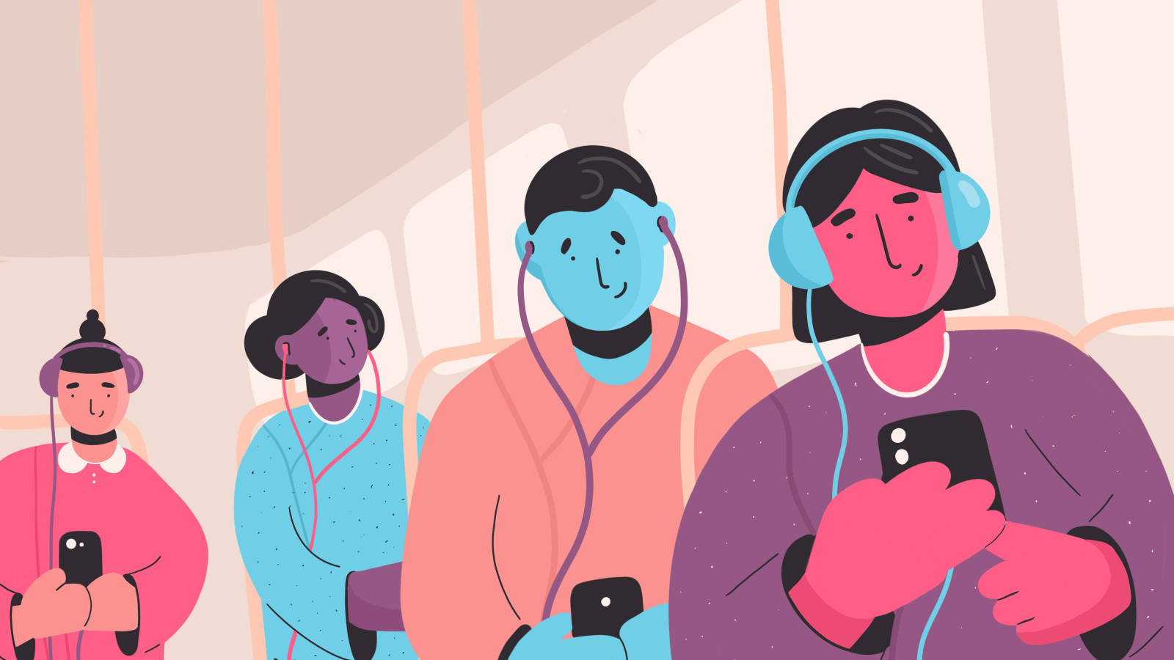


Inferring Songs Skip Patterns
from Spotify’s data
Ravitashaw Bathla

Slide 2


Inference Questions
Shuffled Playlist
01
A user with shuffled playlist is more likely to skip song?
Premium Spotify User
02
Does buying a Spotify premium gets better songs recommendation?
Playlist Type
03
How likely will you skip songs from a friend’s playlist?
Song’s Release Year
04
Are 80s songs more likely to be skipped than 90s?
Song Type
05
Will you skip an instrumental song over a LIVE song?

Slide 3





Data Preparation
\
1 Month
2Billion
Times Sound-tracks Listened
0.3Million
Sound-tracks
783Million
Times Sound-tracks Listened
4Million
Sound-tracks
2 Months

Slide 4


Variables
track_id | premium | shuffle | playlist_type | duration
release_year | us_popularity_estimate | acousticness | beat_strength | bounciness
danceability | energy | flatness | instrumentalness | liveness
loudness | mechanism | organism | speechiness | tempo
valence | skipped_count | not_skipped_count | total_count | release_year_tr

Slide 5
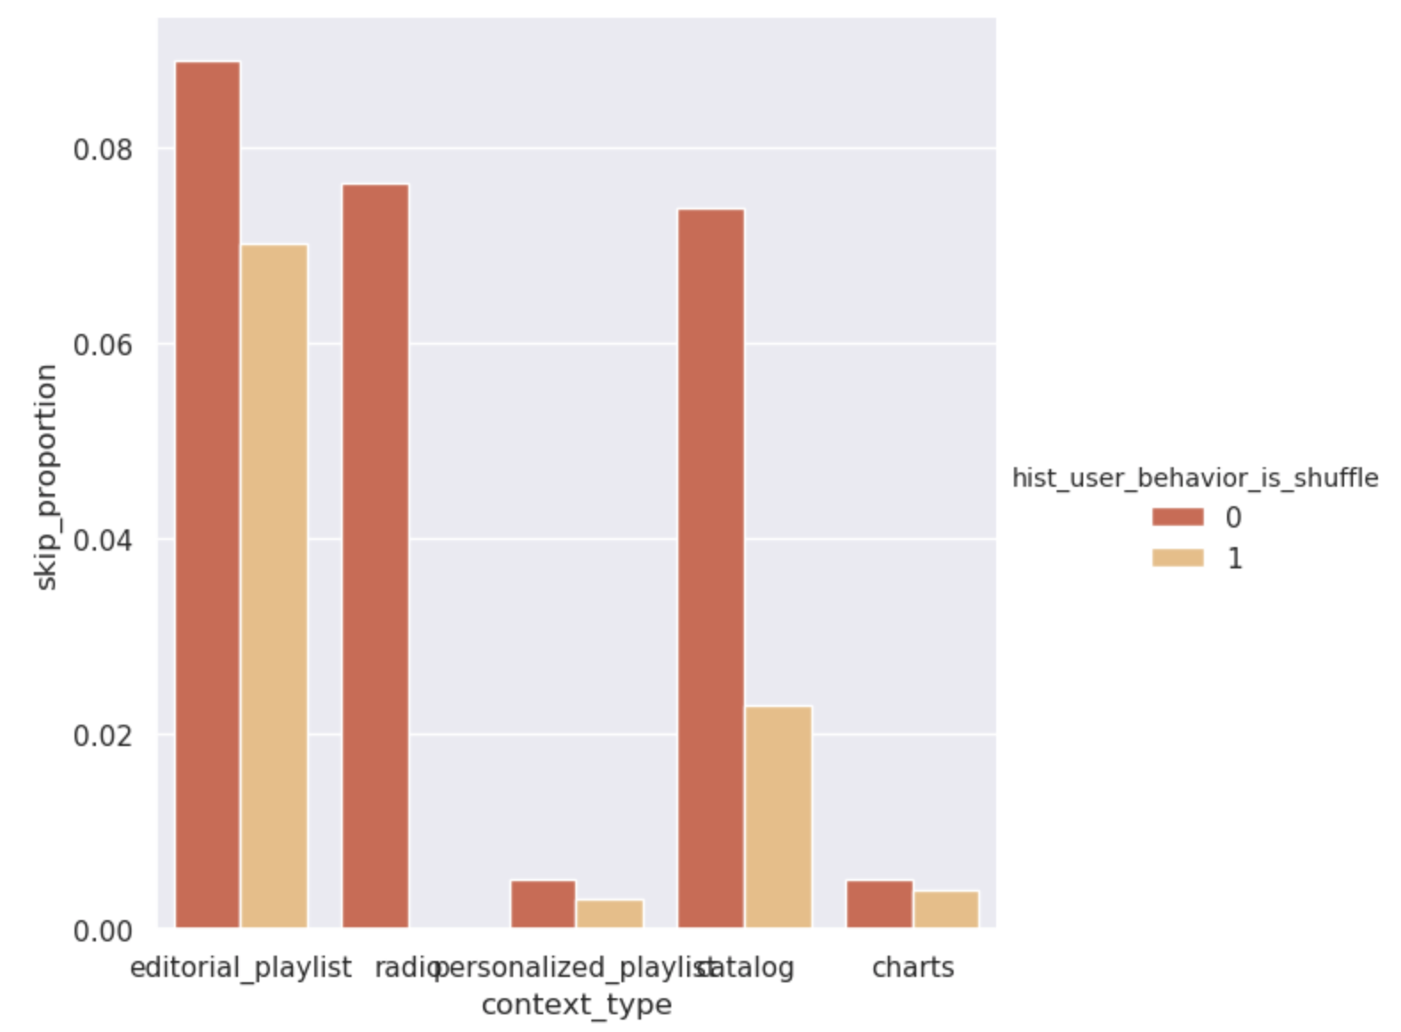

EDA
Skip Proportion of different types of playlist

Slide 6
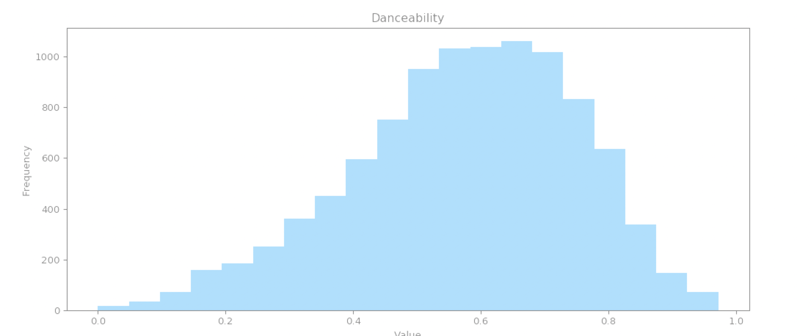
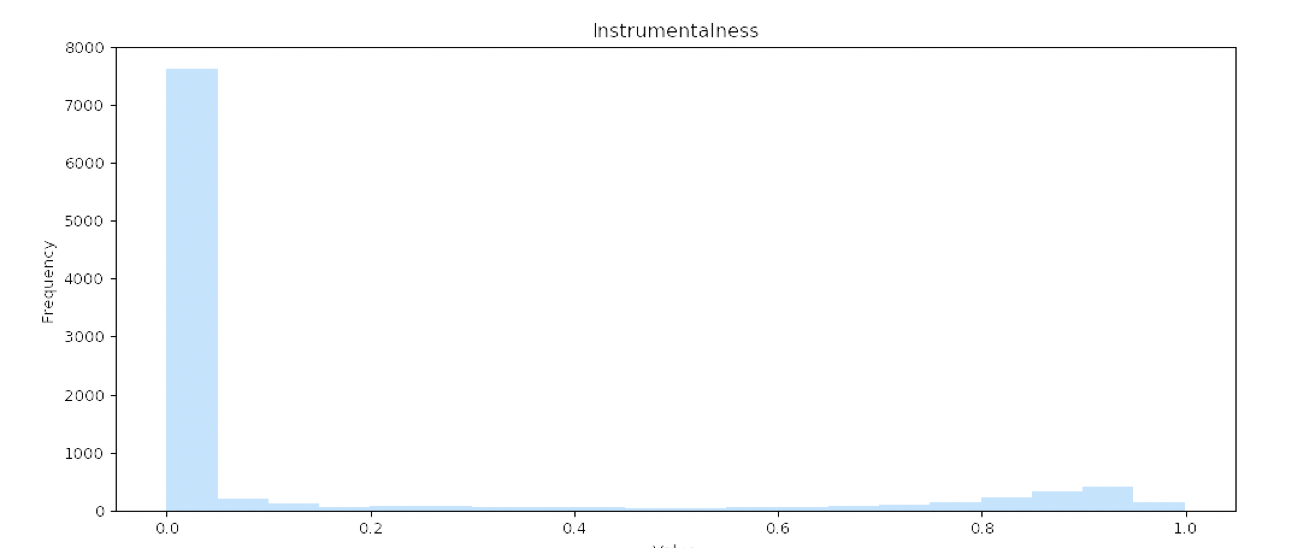




EDA

Slide 7
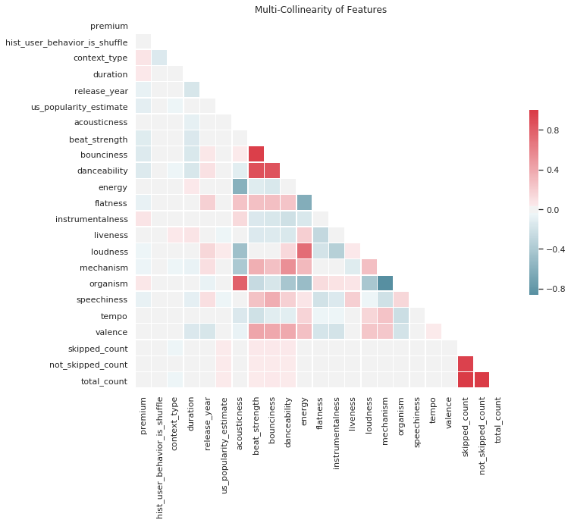
Variable Selection

Slide 8
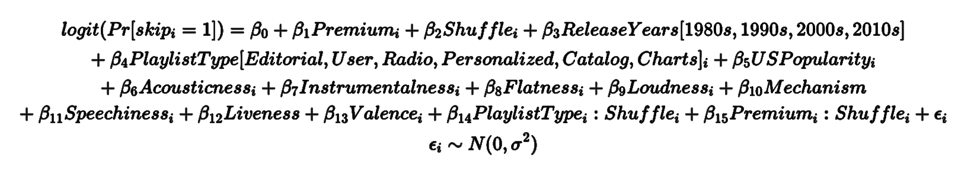
Model

Slide 9
Model Assessment
Accuracy
Precision
Specificity
Sensitivity
Training Data
(70%)
93.74%
93.91%
93.56%
93.77%
Accuracy
Precision
Specificity
Sensitivity
Testing Data
(30%)
93.84%
94.06%
93.63%
93.81%

Slide 10
Conclusion
38%
25%
28%
11%
17%
55%
Less Likely
Less Likely
Less Likely
More Likely
Less Likely
More Likely
Less Likely
More Likely
Shuffled Playlist
Personalized Playlist
Instrumental Songs
2000s Songs
Premium User
Shuffle
+
Friend’s Playlist
Non-Shuffled
Editorial Playlist
Mean Instrumental &
Other song features
1970s
Songs
Non-Premium
User

Slide 11

Questions?

